Slide 1
Steering Wheel Angle Prediction in Autonomous Driving
Aditya Sanjay Nagulpelli 112115010 Bachelor of Technology in Computer Science Engineering
Second Year Project

Slide 2
Contents
Introduction to Autonomous driving
Problem Statement
Dataset and Pre-processing
Data Augmentation
Existing Models
Proposed Model
Results
Conclusion

Slide 3
Introduction to Autonomous driving

Slide 4
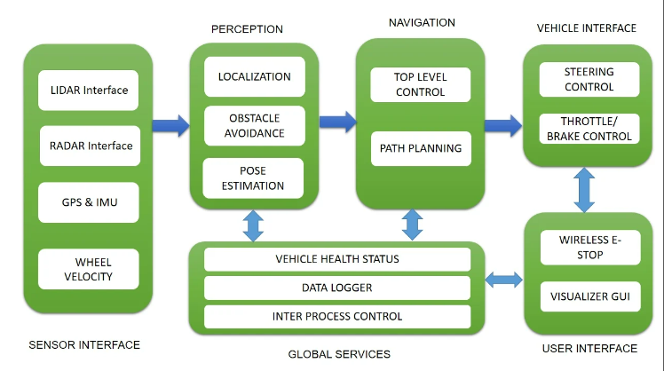

Overview of Data Flow in Autonomous Vehicles

Slide 5
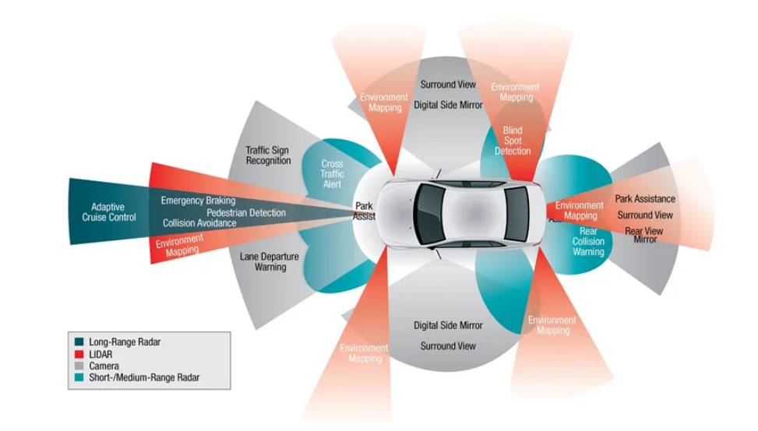
Sensors and their uses

Slide 6
Problem Statement
Developing LSTM based CNN architecture to improve accuracy in steering wheel angle prediction

Slide 7
Dataset and Preprocessing
About Dataset and Operations performed for usability

Slide 8
About Dataset
The data has been collected using Udacity’s self driving car simulator.
The data is of 300MB where each image size if around 18kb
We have images from left, center and right camera at each point
In driving log.csv we have steering angle, speed, throttle, reverse columns along with left_cam, center_cam, right_cam consisting path of images.
There are 3930 entries, 11790 (3930*3) images in our dataset.
Steering angles have been extracted via CAN bus at different time stamp, where it’s value ranges from -1 to +1.

Slide 9
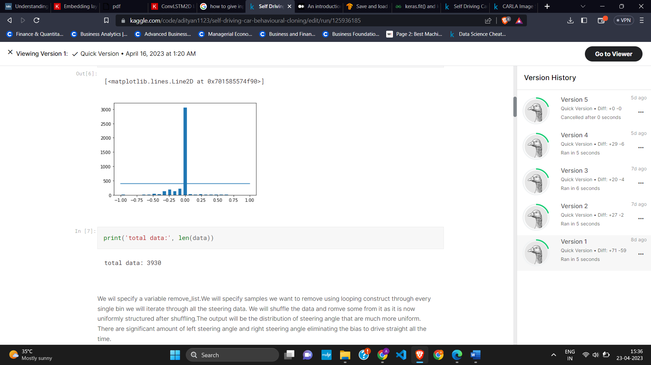
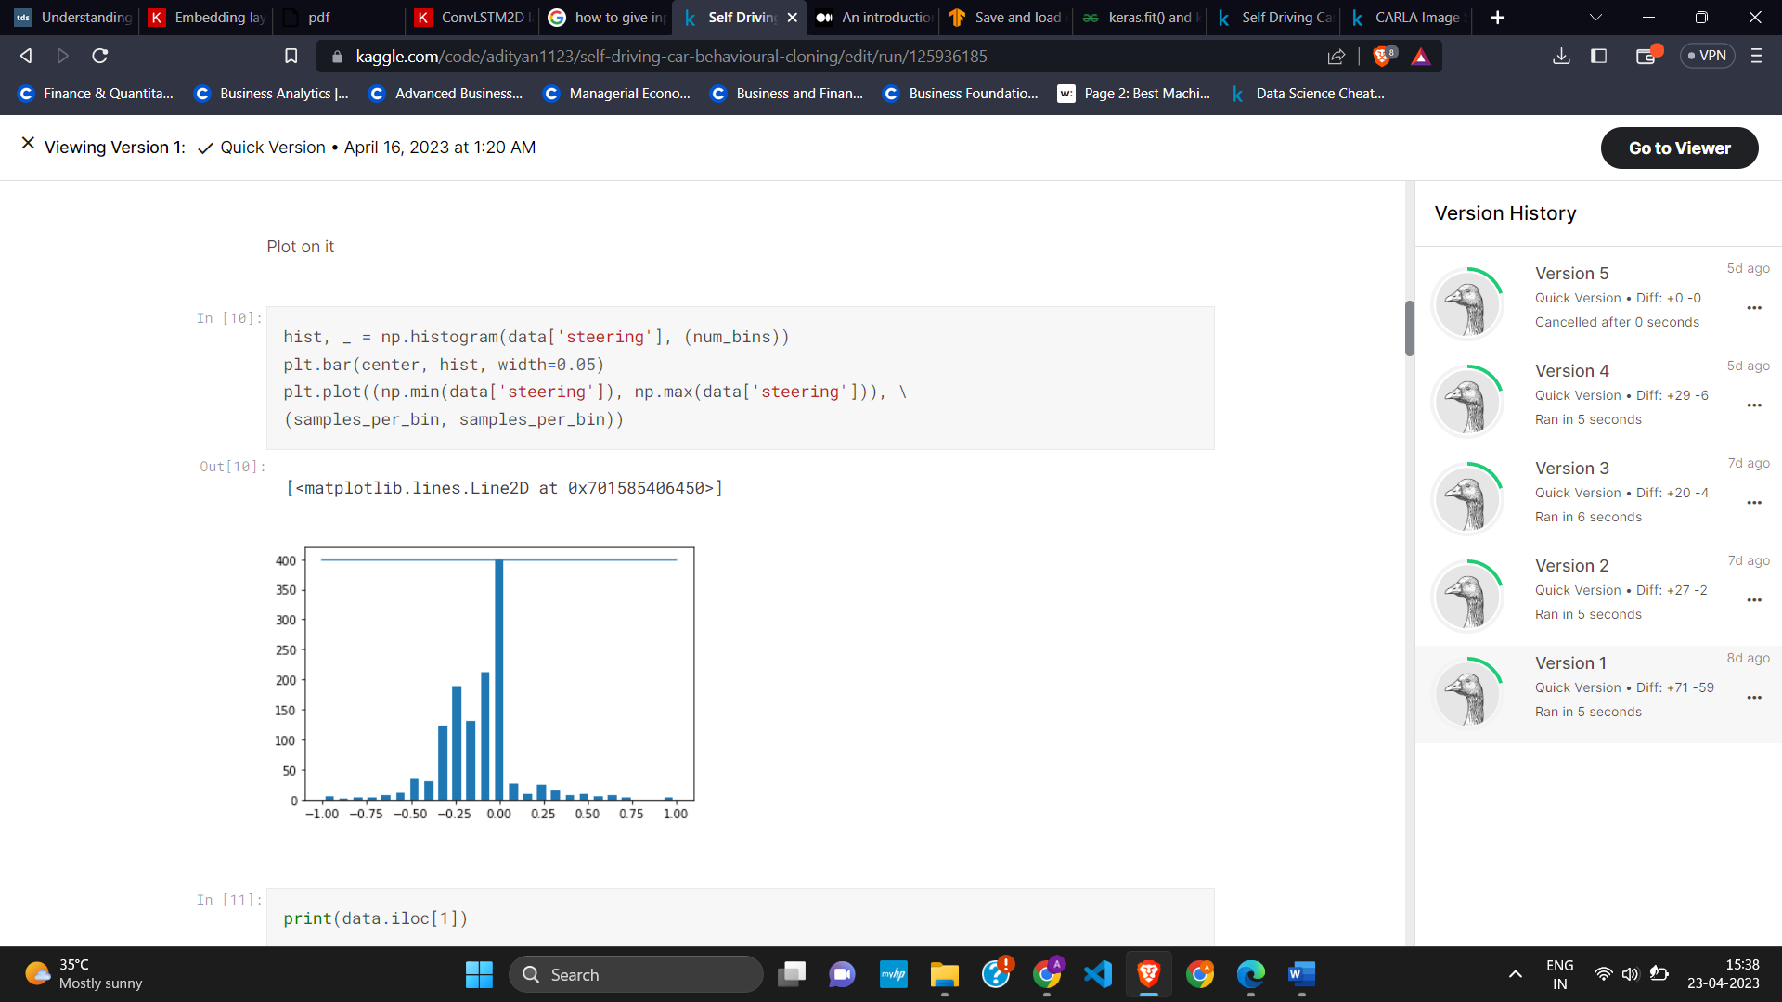
Data Prepossessing
After performing EDA it was found that dataset was imbalanced, so appropriate downsampling was performed.

Slide 10
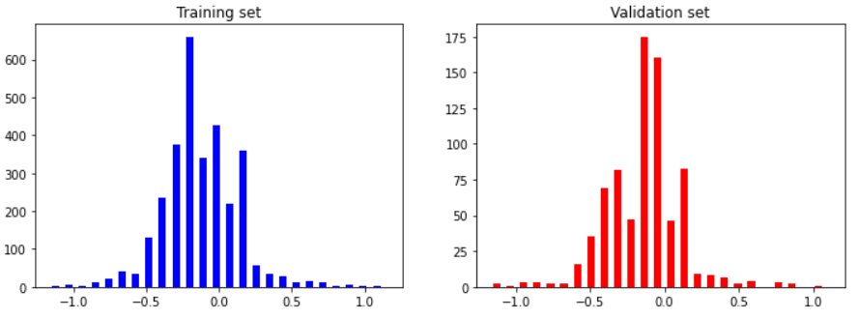
Data Prepossessing
Also, we have modified the data such that there are significant amount of left steering angle and right steering angle.
The train/test split was 80/20.
We have resized the image to (220,66,3) and normalize it.

Slide 11
Data Prepossessing
Data binning (Equal width) was also performed to minimize the effects of small observation errors. And reduce the chance of overfitting as our dataset is not large.
We cropped the image to remove the unnecessary features (60,135).
Changed the images to YUV format.
Used gaussian blur ,kernel (3,3), to remove noise.
Resized for easier processing and normalized the values.
Converted images to numpy array as well.

Slide 12
Data Augmentation
Data augmentation is a technique that can be used to artificially expand the size of a training set by creating modified data from the existing one and prevent overfitting

Slide 13
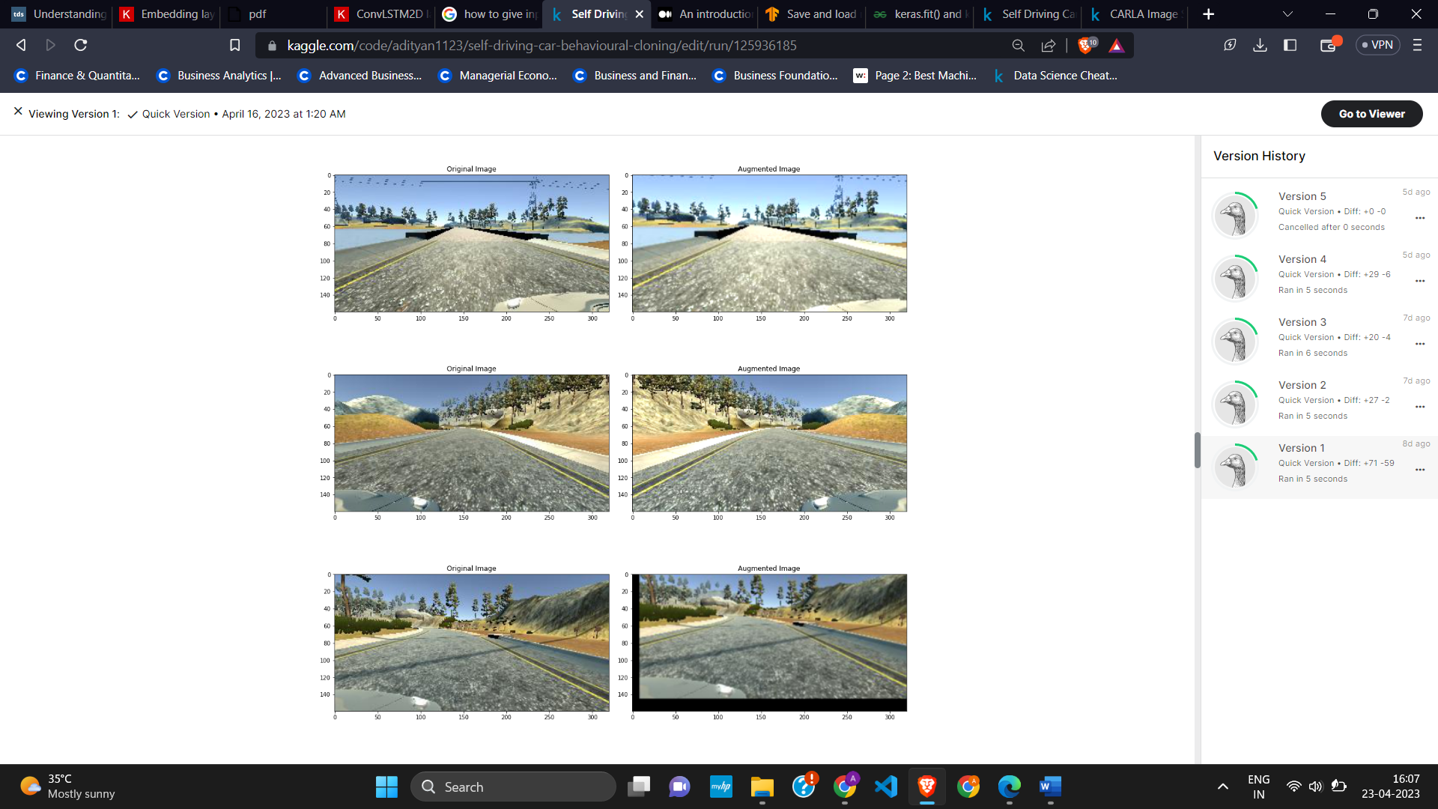
Data Augmentation
Zoom - Relevant features are present in the lowest portion of the photos in the dataset where the road can be seen. The area of the image that is above the external environment will never be used to determine the output; it can therefore be clipped. In the training set, about 30% of the image's top third is trimmed and passed.

Slide 14
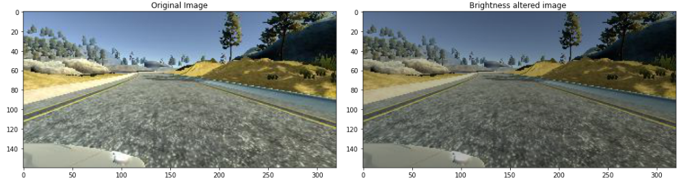
Data Augmentation
Brightness - The brightness enhancement can be quite beneficial when applied generally to weather circumstances with bright sunny days or gloomy, lowlight conditions.

Slide 15
Data Augmentation
Flip - The image is horizontally inverted (i.e., the dataset receives the mirror image of the original image). This serves to teach the model for turns of a similar nature on opposite sides as well.

Slide 16
Data Augmentation
Shift – The image is shifted horizontally and vertically by 10%.

Slide 17
Existing Models

Slide 18
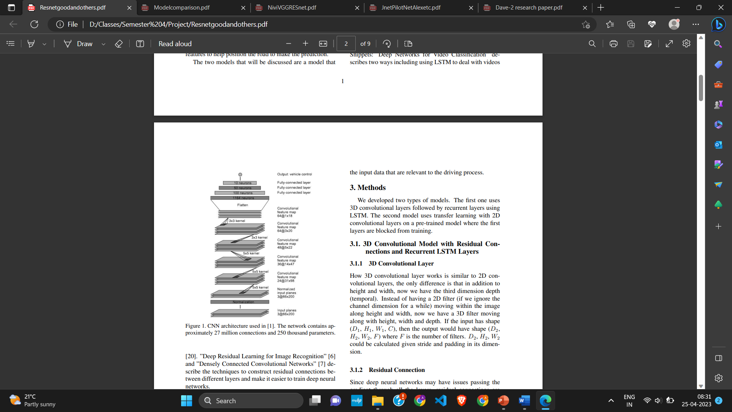
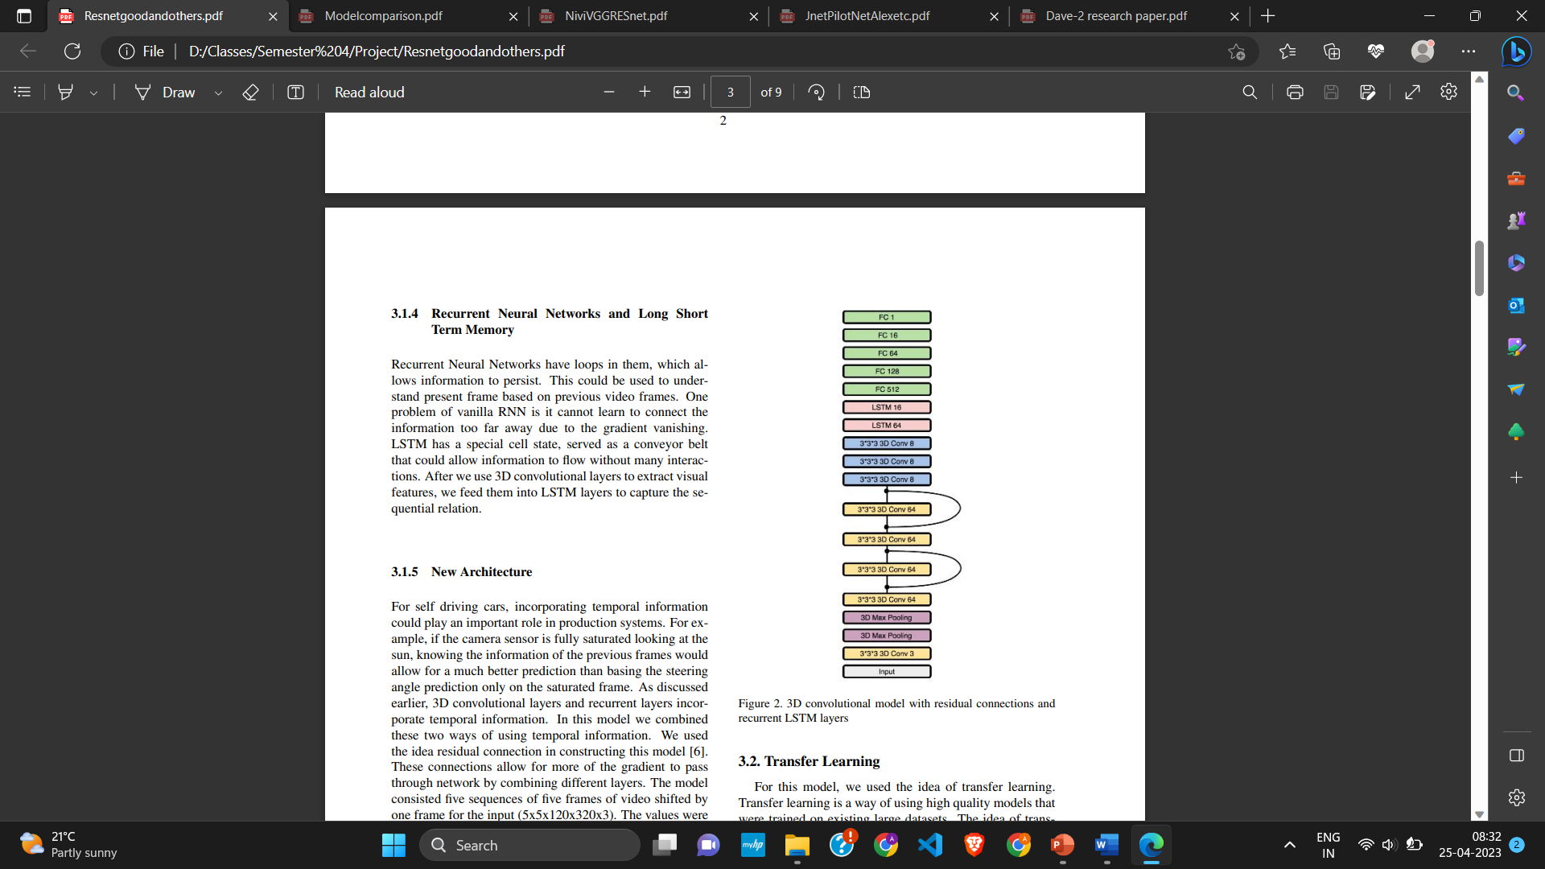
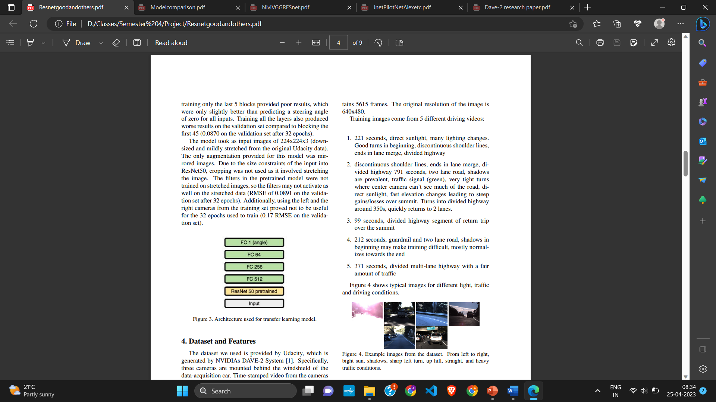
Research Paper – “Self-Driving Car Steering Angle Prediction Based on Image Recognition”
Dataset used was a real – time dataset
Model1 (Nvidia) Model2 Model3 (best)

Slide 19
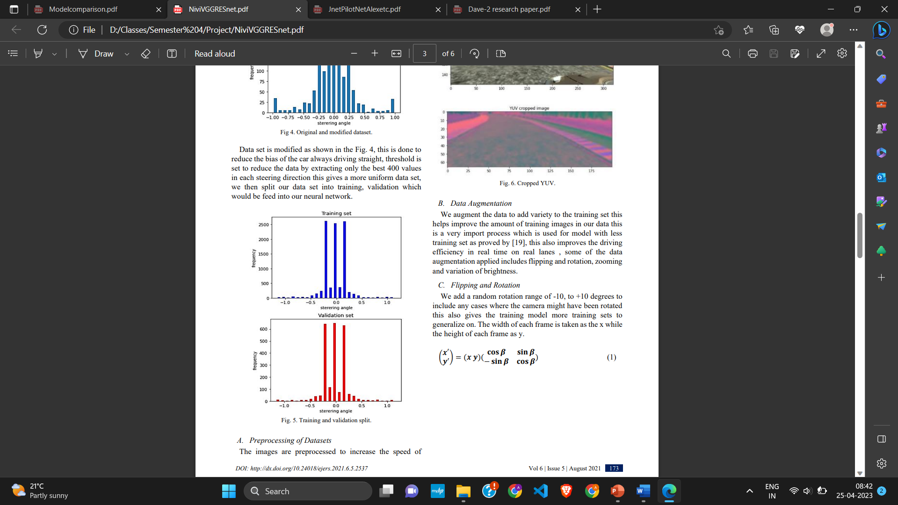
Research Paper – “Prediction of Steering Angle for Autonomous Vehicles Using Pre-Trained Neural Network”
Dataset used was from Udacity simulator but preprocessing was not performed well as it was bit biased
This research paper compares pre-trained VGG16, pre-trained resnet50 and Nvidia Model (PilotNet).
Pre-trained VGG16 performed best.

Slide 20
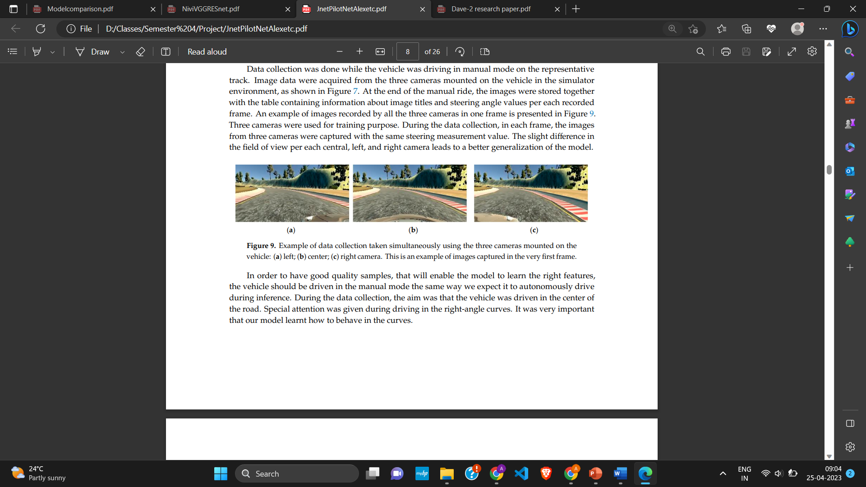
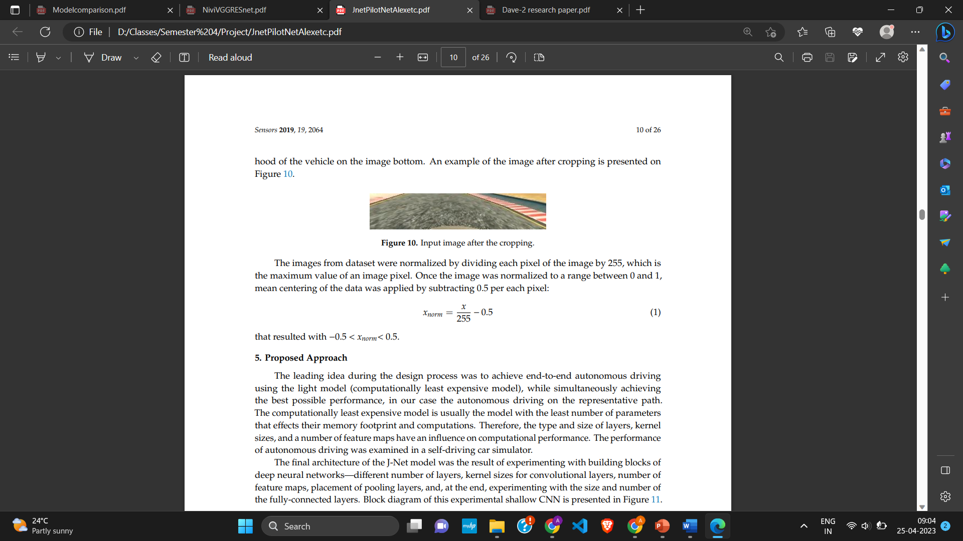
Sensors Article - “An End-to-End Deep Neural Network for Autonomous Driving Designed for Embedded Automotive Platforms”
The goal of the proposed deep neural network was to downsized the needs for real-time inference hardware in terms of computational power, cost, and size.
Hence they have cropped the image significantly. We do not found this useful as there maybe traffic sign and many other things we may miss due to this.
They have compared slight variation of AlexNet, PilotNet and their proposed model j-net.

Slide 21
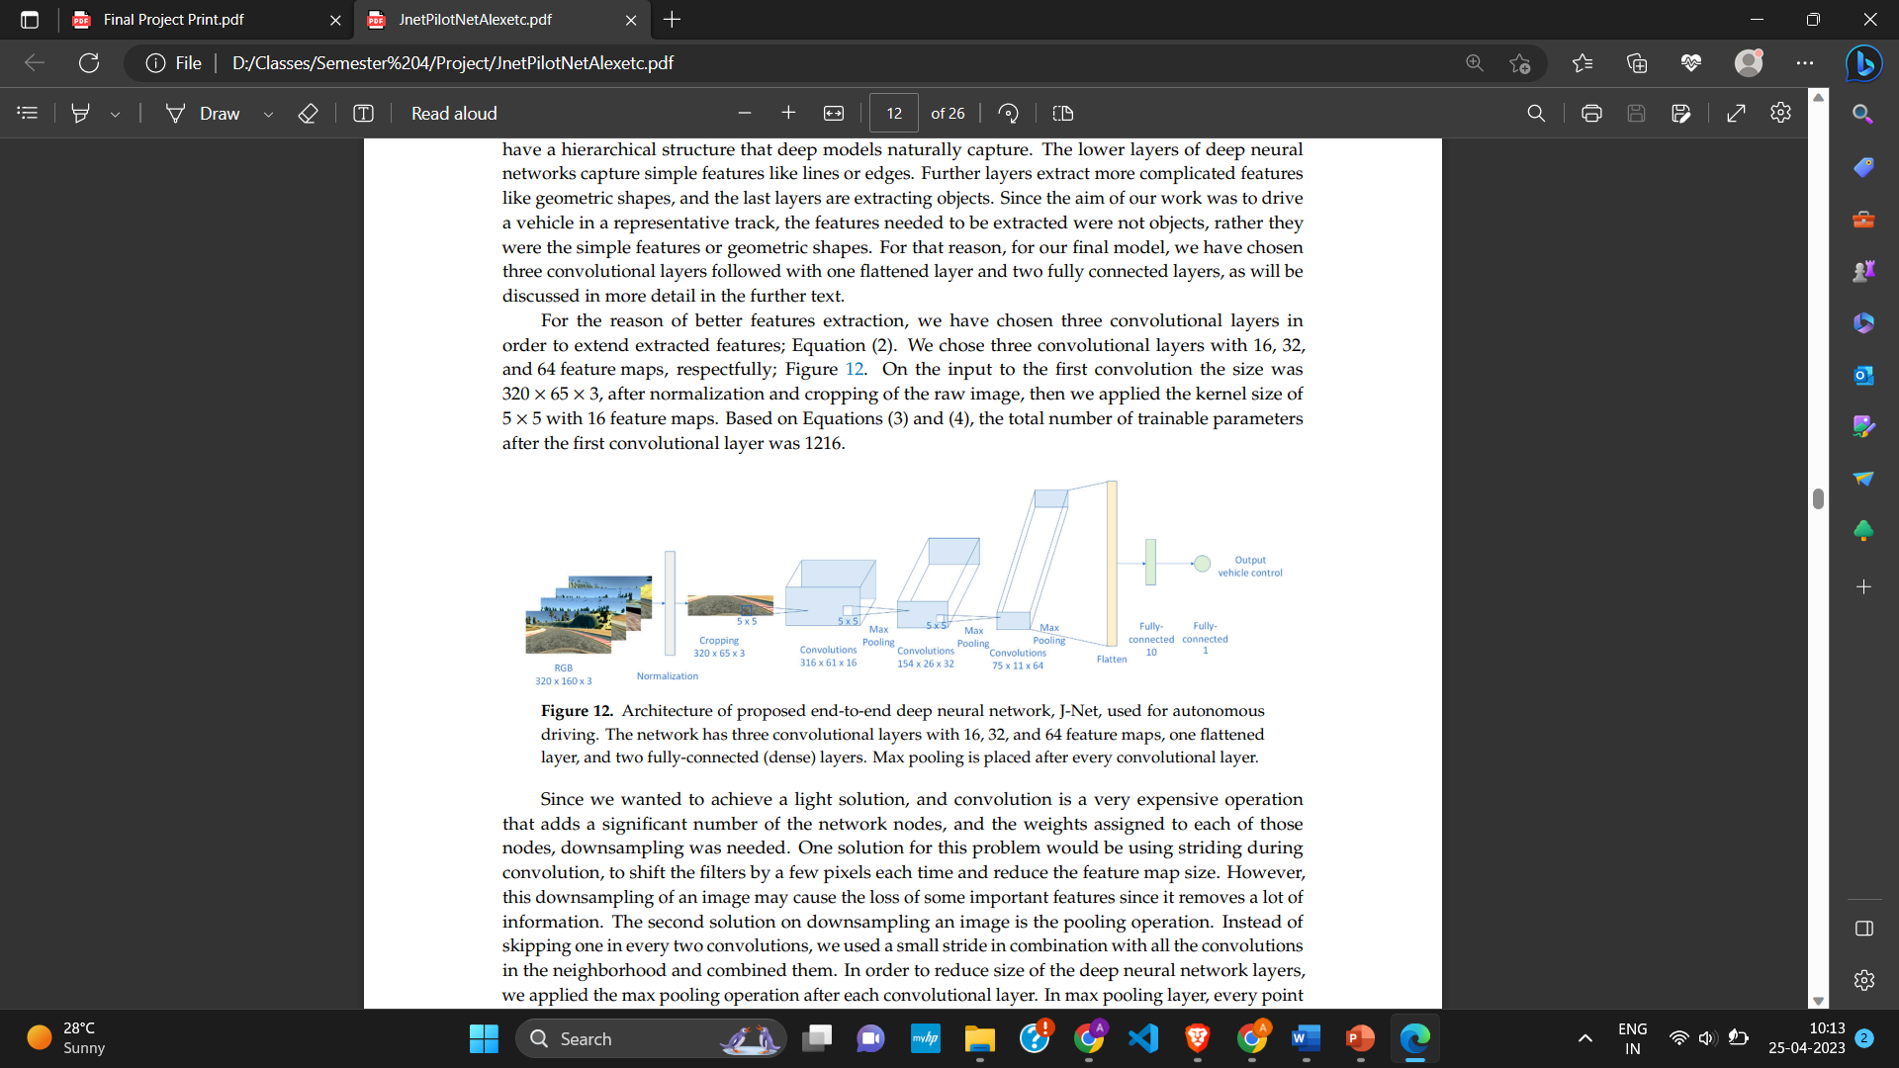
J-Net Architecture
L1 - 16 filters, Kernel (5,5), stride (2,2), activation=“elu”
L2 - 32 filters, Kernel (5,5), stride (2,2), activation=“elu”
L3 - 64 filters, Kernel (5,5), stride (1,1), activation=“elu”
L4 – Max pooling (2,2)
L5 – Flattening,
L6 – Dense(10)
L7 – Dense(1)

Slide 22
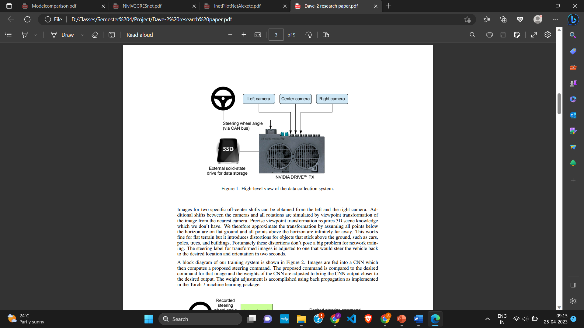
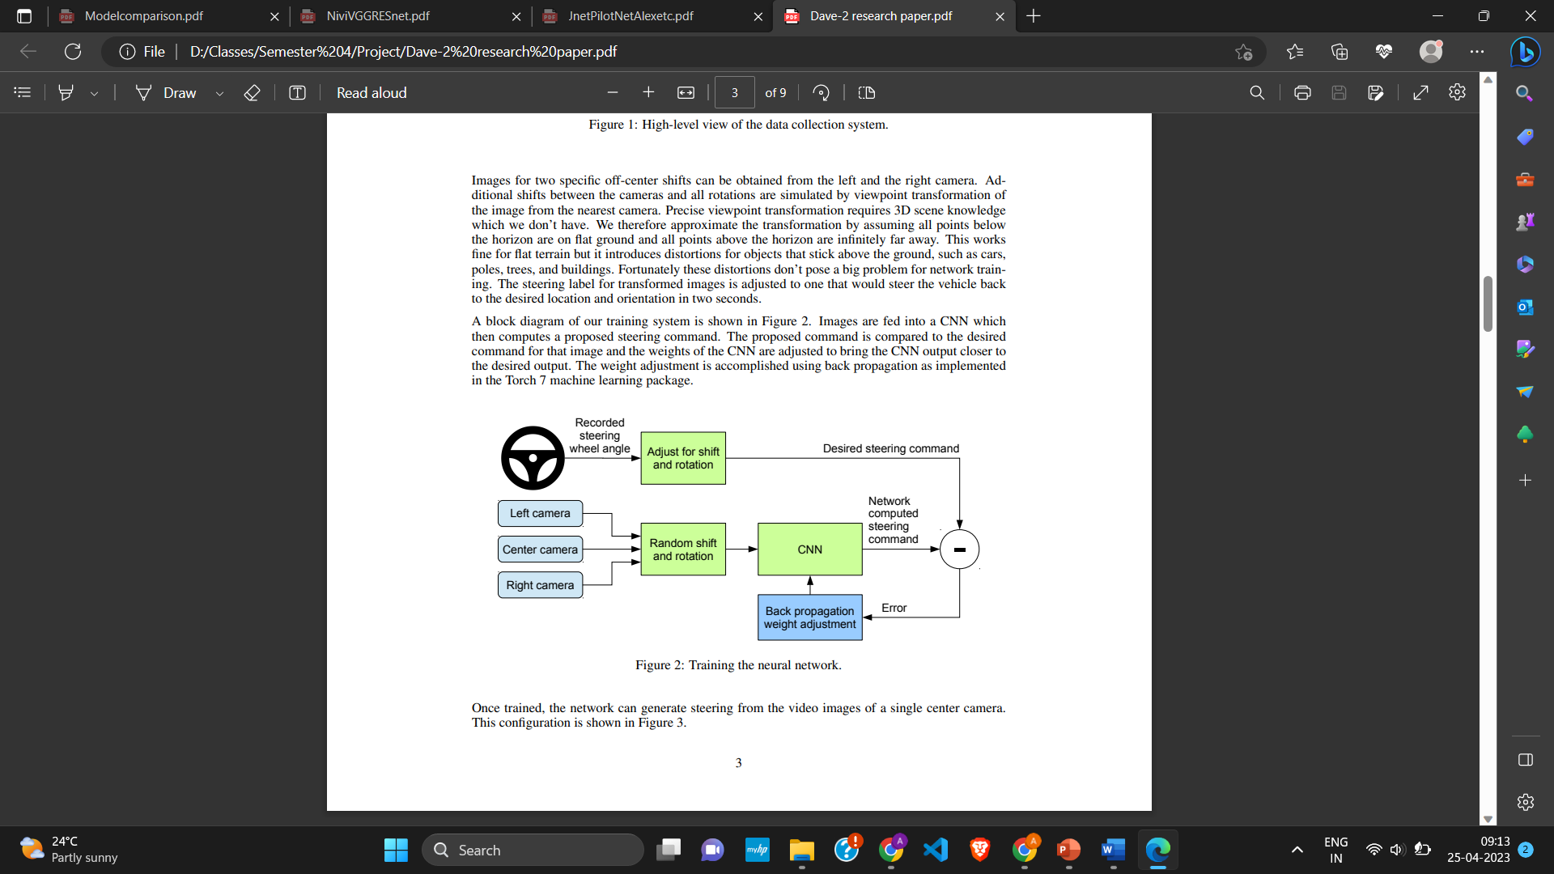
Research Paper - ”End to End Learning for Self-Driving Cars “ by NVIDIA Corp
Though slight old this is a classical research paper whose performance is compared in all the paper. Also known as PilotNet
It gives an End to end approach for self driving cars. However, our primary focus has been on CNN architecture proposed in this paper.

Slide 23
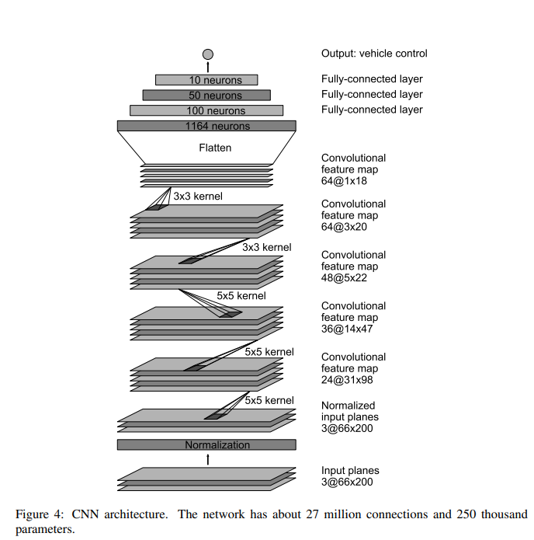
PilotNet Architecture
L1 - 24 filters, Kernel (5,5)
L2 - 36 filters, Kernel (5,5)
L3 - 48 filters, Kernel (3,3)
L3 - 64 filters, Kernel (3,3)
L4 - 64 filters, Kernel (3,3)
L5 – Flattening
L6 – Dense(1164)
L6 – Dense(100)
L7 – Dense(50)
L8 – Dense(10)
L9 – Dense(1)

Slide 24
Proposed Model
Our proposed model consist of 4 convolutional long short-term memory layers followed by appropriate flatten, dense and dropout layers.

Slide 25
Larva Model
What we essentially wanted to do was induce LSTM into CNN architecture as driving is a continuous task and LSTM’s have known to perform good on these kinds of time series data.
Due to time constraints we have not tried many variation as even after using GPU it was quite time consuming.
We tried to stick to the base architecture as in PilotNet and J-net with significant modifications.

Slide 26
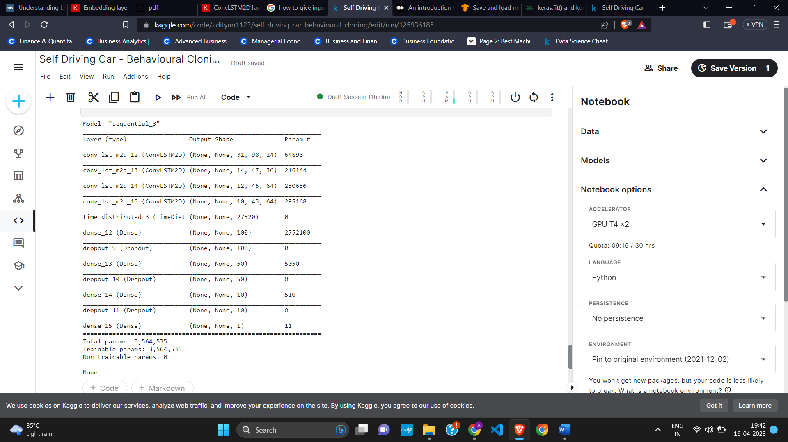
Larva Model
L1 - 24 filters, Kernel (5,5), stride (2,2), activation=“elu”
L2 - 36 filters, Kernel (5,5), stride (2,2), activation=“elu”
L3 - 64 filters, Kernel (3,3), stride (1,1), activation=“elu”
L4 - 64 filters, Kernel (3,3), stride (1,1), activation=“elu”
L5 - Time Distributed Flattening
L6 – Dense(100) , Dropout(0.5)
L7 – Dense(50) , Dropout(0.5)
L8 – Dense(10) , Dropout(0.5)
L9 – Dense(1)

Slide 27
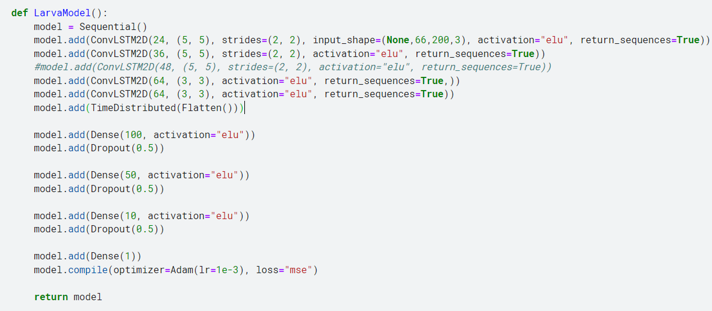
Code snippet

Slide 28
Results

Slide 29
Evaluation
We have picked and compared the model which achieved best accuracy in each research paper.
We have used Mean Squared Error (MSE) as loss function.
We have used Adam optimizer for all networks as it generally performs well.
We have used ImageNet weights for both resnet50 and vgg16 pretrained models
We found the proposed model to have best accuracy among all.
Larva = 0.0198, Nvidia = 0.0281, ResNet50 – 0.0450, VGG16 – 0.0742

Slide 30
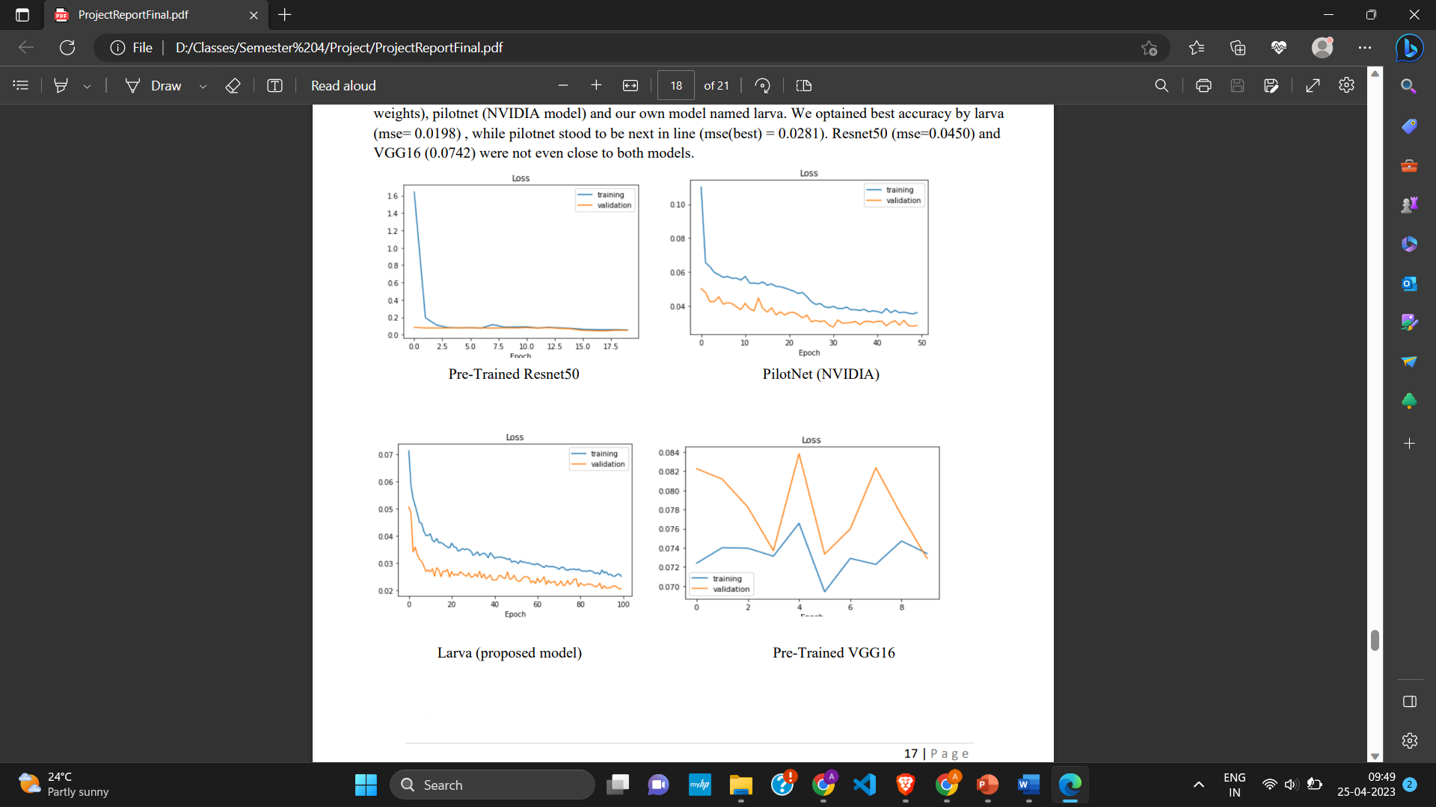
Graphs for Models

Slide 31
Conclusion

Slide 32
Conclusion
We have shown that both, conventional models and a more advanced architecture have promise in the field of autonomous vehicles.
The larva (proposed) model was limited by computational resources, but overall, it still provided a good result from a novel architecture.
In future, the larva model’s architecture could be expanded by having a larger and deeper layers, which may produce better results. Also, hyperparameter tuning and trying different variation like max-pooling or subsampling could enhance the performance.
These models are far from perfect and there is substantial research that still needs to be done on the subject before models like these can be deployed widely to transport the public.

Slide 33
Thankyou

Slide 35
Larva model Snippet

Slide 36
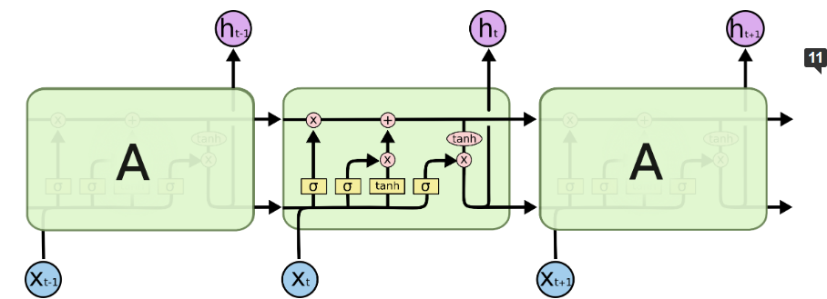
LSTM cell Credits - https://colah.github.io/posts/2015-08-Understanding-LSTMs/

Slide 37
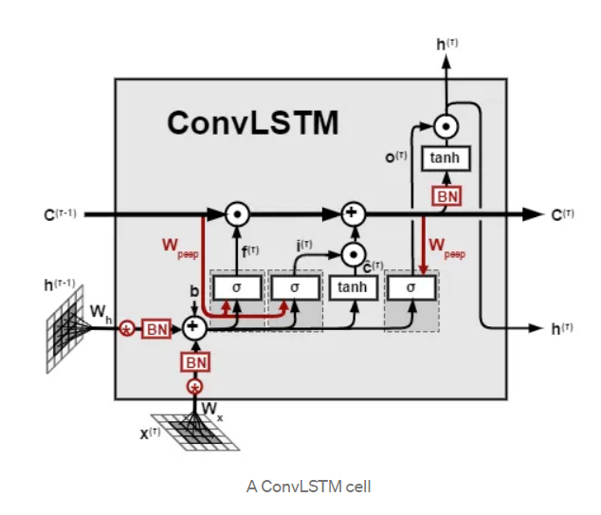
ConvLSTM Credits - https://medium.com/neuronio/an-introduction-to-convlstm-55c9025563a7

